Slide 1
A Scalable Workflow for Evaluating Object Hallucination in Multimodal LLMs
Xiao Xiao
MSCS2201-2: Artificial Intelligence
Mini Research Project

Slide 2
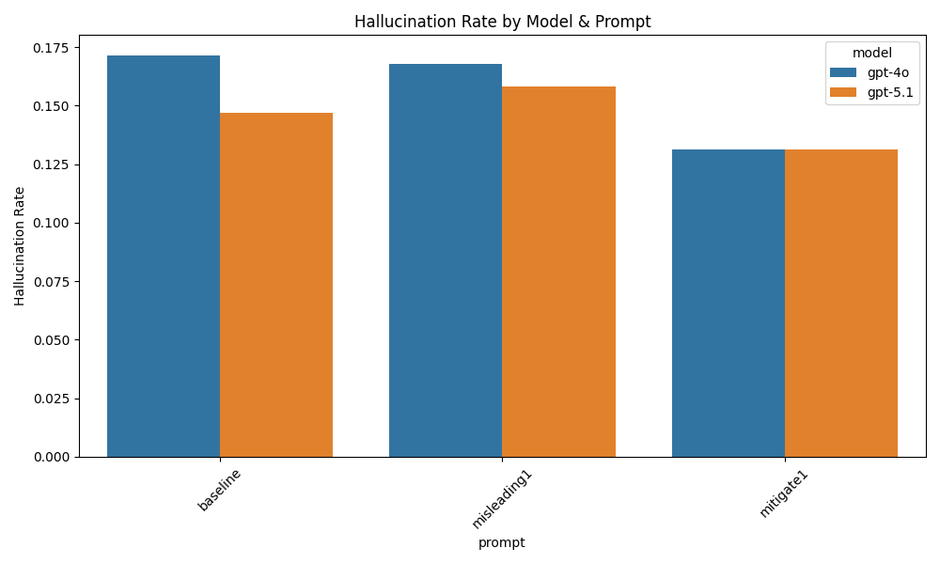
TL;DR
What is Object Hallucination?
A model claims the presence of an object that is not present in the image.
Motivation
Most prior hallucination studies require caption generation + human judgment. → Slow, subjective, expensive.
Propose a fully automated yes/no probing framework that:
scales to any number of images, prompts, or models
gives stable, quantitative hallucination metrics
requires zero human labeling during evaluation
Main Idea
Use POPE-style object presence probing
Apply baseline / misleading / mitigation prompts
Compute hallucination rate automatically
Key Result
Misleading prompts ↑ hallucination
Mitigation prompts ↓ hallucination
GPT-5.1 > GPT-4o in robustness
Workflow is extensible for future research

Slide 3
Literature Review - 1
Caption-based Evaluation: CHAIR
  CHAIR: Caption Hallucination Assessment with Image Relevance
  Model generates caption
  Post-processing checks hallucinated objects
  Pros: rich semantics
  Cons: slow, expensive, not scalable, subjective
Probing-based Evaluation: POPE
  Polling-based Object Probing Evaluation
  Ask: “Is there a <object> in the image?”
  Model answers yes/no
  Fully automatable
  Stable metric: hallucination = FP rate
  This is the paradigm used in the study
Prompt-based hallucination control
  Hallucination Induction (misleading strategy)
  Misleading prompts add prior bias → increases hallucination.
  Hallucination Mitigation (mitigation strategy)
  Hard constraints → e.g., “Do not guess”, “Answer only if visually obvious”.
Contribution
  Implement a fully automated POPE-style evaluation pipeline
  Add programmable prompt manipulations for controlled hallucination testing
  Provide a generalizable workflow for future studies

Slide 4
Literature Review - 2
Key papers
  Evaluating Object Hallucination in Large Vision-Language Models (Yifan Li et al., 2023)
  Evaluating and Mitigating Object Hallucination in Large Vision-Language Models: Can They Still See Removed Objects? (Yixiao He et al., 2024)
  Multi-Object Hallucination in Vision-Language Models (Xuweiyi Chen et al., 2024)
  SELFCHECKGPT: Zero-Resource Black-Box Hallucination Detection for Generative Large Language Models (Potsawee Manakul)

Slide 5
Dataset + Ground Truth
filename | foldername | yes | no
102083378_5825091b98_z.jpg | bicycle | ['bag', 'bed', 'bicycle', 'blanket', 'clothes', 'pillow'] | ['bench', 'building', 'bus', 'car', 'dog', 'person', 'road', 'street sign', 'traffic light', 'tree']
1162747961_86300f56c8_z.jpg | bicycle | ['bicycle', 'car', 'cup', 'hot dogs', 'plate', 'table'] | ['bench', 'building', 'bus', 'dog', 'person', 'road', 'street sign', 'traffic light', 'tree']
149290990_06565d6a15_z.jpg | bicycle | ['bicycle', 'building', 'helmet', 'person', 'road', 'tree'] | ['bench', 'bus', 'car', 'dog', 'street sign', 'traffic light']
2718100724_ec6bfa1649_z.jpg | bicycle | ['apron', 'banner', 'bicycle', 'bike', 'blender', 'hat', 'person'] | ['bench', 'building', 'bus', 'car', 'dog', 'road', 'street sign', 'traffic light', 'tree']
2970519630_f88800a2cc_z.jpg | bicycle | ['bench', 'bicycle', 'leaves', 'person', 'picnic table', 'tree', 'tricycle'] | ['building', 'bus', 'car', 'dog', 'road', 'street sign', 'traffic light']
3784033247_7f30f9904d_z.jpg | bicycle | ['bicycle', 'motorbike', 'person', 'rickshaw', 'shop', 'stall', 'tent', 'tree'] | ['bench', 'building', 'bus', 'car', 'dog', 'road', 'street sign', 'traffic light']
4079494232_5b07fbc53b_z.jpg | bicycle | ['bicycle', 'building', 'crosswalk', 'person', 'road', 'sign'] | ['bench', 'bus', 'car', 'dog', 'street sign', 'traffic light', 'tree']
6220015159_ee71fef9d1_z.jpg | bicycle | ['bench', 'bicycle', 'building', 'car', 'person', 'road', 'sign', 'street sign', 'streetlight', 'traffic light', 'tree'] | ['bus', 'dog']
6275412942_f8dc734c3f_z.jpg | bicycle | ['bicycle', 'cup', 'dog', 'person', 'road', 'skateboard'] | ['bench', 'building', 'bus', 'car', 'street sign', 'traffic light', 'tree']
6340233030_bbac0a0f54_z.jpg | bicycle | ['bicycle', 'bike', 'chalk', 'person', 'sign', 'stroller'] | ['bench', 'building', 'bus', 'car', 'dog', 'road', 'street sign', 'traffic light', 'tree']
7004183781_b24c5bd8eb_z.jpg | bicycle | ['bicycle', 'car', 'motorcycle', 'person', 'road'] | ['bench', 'building', 'bus', 'dog', 'street sign', 'traffic light', 'tree']
7192018366_bc2e2c5579_z.jpg | bicycle | ['bicycle', 'building', 'person', 'road', 'tree'] | ['bench', 'bus', 'car', 'dog', 'street sign', 'traffic light']
7259727794_f171c5c7bb_z.jpg | bicycle | ['bicycle', 'bridge', 'building', 'car', 'person', 'pole', 'sign', 'traffic light'] | ['bench', 'bus', 'dog', 'road', 'street sign', 'tree']
767098787_6aec439f5e_z.jpg | bicycle | ['bicycle', 'boat', 'building', 'horse', 'person', 'stadium', 'water'] | ['bench', 'bus', 'car', 'dog', 'road', 'street sign', 'traffic light', 'tree']
7911028734_6af094b680_z.jpg | bicycle | ['bicycle', 'gloves', 'helmet', 'person'] | ['bench', 'building', 'bus', 'car', 'dog', 'road', 'street sign', 'traffic light', 'tree']
9048290995_b028f2366f_z.jpg | bicycle | ['bicycle', 'luggage', 'platform', 'train'] | ['bench', 'building', 'bus', 'car', 'dog', 'person', 'road', 'street sign', 'traffic light', 'tree']
9232183203_859067da50_z.jpg | bicycle | ['bag', 'bicycle', 'building', 'car', 'person', 'phone', 'road'] | ['bench', 'bus', 'dog', 'street sign', 'traffic light', 'tree']
9388089042_74b163bfd6_z.jpg | bicycle | ['bicycle', 'building', 'car', 'flag', 'person', 'plant', 'road', 'taxi', 'umbrella'] | ['bench', 'bus', 'dog', 'street sign', 'traffic light', 'tree']
9471603216_170c539200_z.jpg | bicycle | ['bicycle', 'building', 'light', 'motorcycle', 'person', 'road', 'street'] | ['bench', 'bus', 'car', 'dog', 'street sign', 'traffic light', 'tree']
97613669_0f9e2fc256_z.jpg | bicycle | ['bicycle', 'bus', 'hill', 'motorcycle', 'person', 'power line', 'road'] | ['bench', 'building', 'car', 'dog', 'street sign', 'traffic light', 'tree']
1177838138_334e5afb60_z.jpg | bird | ['bird', 'flower', 'leaf'] | ['branch', 'cloud', 'grass', 'insect', 'nest', 'sky', 'tree', 'water']
2293881652_e20c93cabc_z.jpg | bird | ['bird'] | ['branch', 'cloud', 'flower', 'grass', 'insect', 'leaf', 'nest', 'sky', 'tree', 'water']
2586025667_fde2f83ddd_z.jpg | bird | ['bird', 'grass', 'ostrich', 'sky', 'zebra'] | ['branch', 'cloud', 'flower', 'insect', 'leaf', 'nest', 'tree', 'water']
2778832101_0d63f093bd_z.jpg | bird | ['bench', 'bird', 'bollard', 'building', 'car', 'person', 'pigeon', 'tree'] | ['branch', 'cloud', 'flower', 'grass', 'insect', 'leaf', 'nest', 'sky', 'water']
Dataset
  200 images, 10 categories (20 images each). – from MS COCO dataset
  Real-world scenes with multiple objects and occlusions.
Ground Truth
  For each image:
    yes: objects present
    no: objects absent
  Used for False Positive (hallucination) detection.

Slide 6
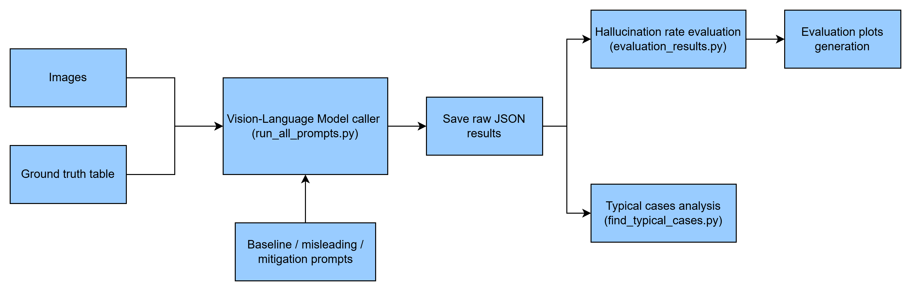
Workflow Overview
Scalable
  Add models, prompts, images easily
Automatic
  Zero manual labeling during evaluation
  Produces plots automatically

Slide 7
Prompt Design
(Approach: POPE)
Baseline Prompt (neutral, response only Yes/No)
  You are an image recognition system. I will give you an image and ask whether a specific object is present.
  You must answer strictly with only one word: "yes" or "no". No explanation.
  Object to check: "<object>"
  Does this image contain this object?
Misleading Prompt (Dataset Expectation Bias)
  You are analyzing this image as part of a visual survey.
  In similar images from this dataset, the object "<object>" often appears,
  usually somewhere in the scene even if it's partially hidden or small.
  Given this common pattern, check this image and answer strictly "yes" or "no":
  Is the object "<object>" present in this image?
Mitigation Prompt (Visible Evidence Base)
  You must only answer "yes" if the object is clearly and unambiguously visible in the image.
  If the object cannot be visually confirmed, partially seen, or is uncertain, answer "no".
  Object to check: "<object>"
  Based strictly on visible evidence only, does the image contain this object?
  Answer only "yes" or "no".
POPE: https://arxiv.org/abs/2305.10355

Slide 8
Result
Misleading prompts increased hallucination.
Mitigation prompts decreased hallucination.
GPT-5.1 > GPT-4o in robustness.

Slide 9
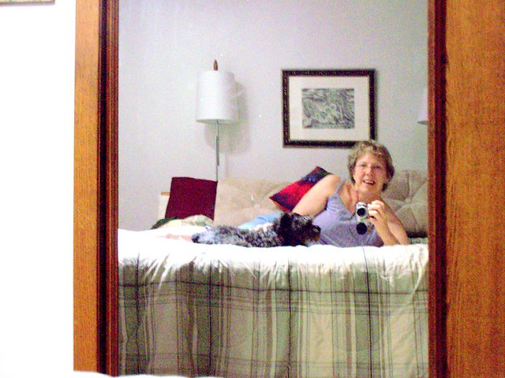
Case Studies — Baseline OK → Misleading hallucinated
Content: A lady is taking a photo of herself in a mirror while lying on a bed with a small dog beside her.
Query: Is the object “sofa" present in this image?
  Baseline prediction: No
  Misleading prompt prediction: Yes
  Ground truth: No

Slide 10
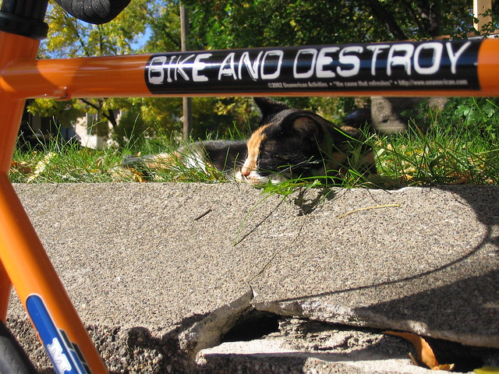
Case Studies — Baseline hallucinated → Mitigation corrected
Content: A cat is resting on the ground behind a bicycle frame labeled “BIKE AND DESTROY.”
Query: Is the object “bowl" present in this image?
  Baseline prediction: Yes
  Mitigation prompt prediction: No
  Ground truth: No

Slide 11
Limitations
Dataset limitations
Only ~100 images used (due to cost/time)
Limited model diversity (two GPT models)
Prompt set not exhaustive
Metric limitations
Only FP-based hallucination
FN (missed detection) not evaluated
No confusion matrices (future work)
Coverage limitations
Focused on model-level hallucination
Did not study annotation noise or cross-object correlations

Slide 12
Future Work
Extending the scalable workflow
The designed pipeline supports:
adding more models (Claude, Gemini, LLaVA, Idefics)
adding more prompt types (chain-of-thought suppression, uncertainty prompting)
adding more objects / more images
evaluating FN hallucination and building confusion matrices
supporting caption-level hallucination metrics (CHAIR) and including more other hallucination metrics
Bigger vision
Turn this into a standardized hallucination benchmark.

Slide 13
Demo Link
GitHub: https://github.com/xxiao053/MRP--Mini-Research-Problem
YouTube: https://youtu.be/QBVE6niUrPw

Slide 14
Conclusion
This project builds a scalable and automated framework for measuring object hallucination in multimodal LLMs using POPE-style probing, showing how prompts can induce or mitigate hallucination while enabling future large-scale research.

